Slide 1
Universal Gravitation
With free fall and weight, too!

Slide 2
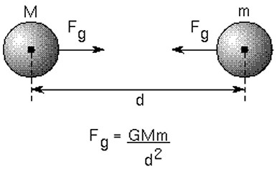
What is universal gravitation?
All objects with mass attract all other objects with mass.
The strength of the gravitational force between the objects depends upon their masses and distance between them
$$F_{g}=G\frac{m_{1}m_{2}}{r^{2}}$$

Slide 3
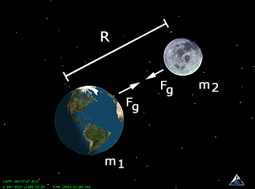
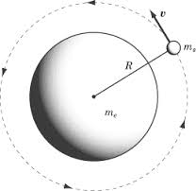
$$F_{g}=G\frac{m_{1}m_{2}}{r^{2}}$$
If either mass doubles, the force between them doubles… the force is proportional to the two masses.
If the distance between the two masses doubles, then the force decreases to one-fourth of what it was… the distance between the masses is inversely proportional to the force.
Note: ‘r’ stands for radius, which is the straight-line distance between the two objects center-of-mass points. The reason Newton used radius instead of distance is because his law of Universal Gravitation explained how moons orbit planets.

Slide 4
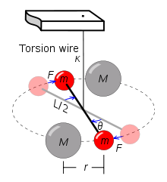

$$F_{g}=G\frac{m_{1}m_{2}}{r^{2}}$$
‘G’ is the gravitational constant and always has a value of $6.67x{10}^{−11}{Nm^{2}}/{{kg}^{2}}$
Newton did not actually know the value of “Big G”. Big G is quite difficult to verify because gravity is the weakest of the fundamental forces, and all tools used in the experiments are themselves subject to Earth’s gravity.
71 years after Newton’s death, Henry Cavendish determined the value of the universal gravitational constant. Originally, Cavendish was investigating another problem, but recognized that he had discovered the value of Big G.
This is a modern torsion balance based on Cavendish’s setup.

Slide 5
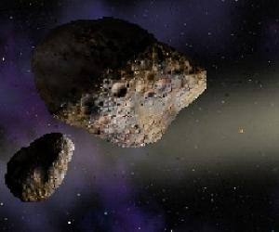
Sample problem
What is the distance between two chunks of asteroid matter that exert a force of 2.34x10² N on each other? One asteroid has a mass of 229,000 kg and the other asteroid has a mass of 7.22x10⁸ kg.

Slide 6
Solution
Rearrange the Univ. Grav. Equation: $\sqrt{\frac{{Gm}_{1}m_{2}}{F_{g}}}=r$
Substitute given values and solve. Don’t forget the sq rt.
Answer is 6.87 meters.

Slide 7
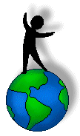
A familiar case of Univ. Gravity
We live on the surface of Earth, and are subject to Earth’s gravitational pull. In fact, we count on it (but more on that when we study weightlessness).
At/near the surface of the Earth, all objects are pulled towards the center of the Earth with the same acceleration. This specific acceleration is called
free fall acceleration = 9.81 m/s²
g = 9.81 m/s²
Physicists use the variable g (notice it is little this time) to represent free fall acceleration.
Is this really true?
Demo and video

Slide 8
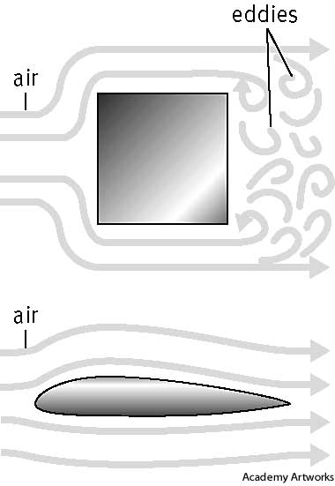
All objects speed up at this rate (9.8 m/s²) when no other forces are acting upon them.
This only happens in a vacuum, which we cannot survive in. (Space is a vacuum!) So, it is unrealistic to always ignore air resistance, but it sure does make the math easier. And recall from our previous lecture how variable air friction is? Dealing with air resistance is tricky, but in many cases F_{air} is negligible; for instance dropping a steel marble from a 2m height.
Terminal velocity is the maximum velocity a falling object will travel as limited by air resistance.
F_{g}
-mass to surface area ratio affects terminal velocity
example:
Dropping a single sheet of paper vs. dropping a magazine. Which one is more affected by air resistance?
F_{g}
Speeding up
At terminal
velocity
F_{air}
F_{air}
- aerodynamic objects have a higher terminal velocity

Slide 9
Gravitational Force
So, regardless of the amount of mass of any object, near the surface of the Earth they accelerate at 9.81 m/s² …ignoring air resistance.
And if we apply Newton’s Second Law, F=ma, then we can find the gravitational force on any mass near the surface of Earth.
$$F_{g}=mg$$
Sample Problems:
What is the force exerted by Earth on an apple with a mass of 0.33 kg?
If the force of gravity on a chair is 196.2 N, how much is the chair’s mass?
Notes:
Answers: the apple experiences a force of 3.24N; the chair has a mass of 20kg

Slide 10
Visiting other planets
And if we were to travel to other planets, we can calculate the force they would exert on us by knowing their specific free fall accelerations. Here are some known planetary accelerations:
“g_{Earth}” is approximately 9.81 m/s²
“g_{Mars}” is approximately 3.73 m/s²
“g_{Venus}” is approximately 8.7 m/s²
“g_{Saturn}” is approximately 11.2 m/s²
“g_{Jupiter}” is approximately 24.79 m/s² (wow!)
What force would Jupiter exert on a 75kg satellite?
If the Earth exerts a force of 20,601 N on a space vehicle, what gravitational force will Mars exert? (This is a 2-step problem. Think!)
Notes:
Answers: 1850 N on the satellite at Jupiter; 2100 kg space vehicle will experience 7833 N of force on Mars

Slide 11
Wait! Let’s talk about weight
Weight is a concept! It is easy to become confused if you don’t grasp the minutiae of this concept.
Weight (usually) has a numerical value that is equal to gravitational force. F_{g}=mg
BUT weight is not realized without the ground reaction force resisting the gravitational pull on a mass.
Think about it:
When you’ve been standing for awhile, where do you feel your weight?
When you’ve been riding in a car, taking a long trip, where do you feel your weight?
If you do a hand-stand, where do you feel your weight?
Please note! Weight is never equal to mass!
An object’s mass is always the amount of matter it is made of. It does not change! Nor is it dependent upon its interaction with other objects.
Weight, on the other hand, does depend on location and the other objects a mass is interacting with. Your weight changes when you visit the moon, but not your mass! You have no weight in free fall because nothing is resisting that pull of gravity on your mass.

Slide 12
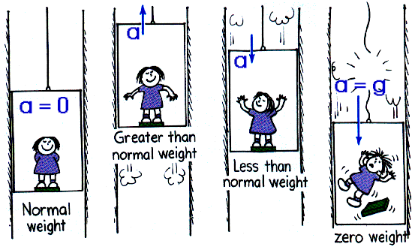
more weight talk
When riding in an elevator your “apparent weight” changes. This is how heavy or weighty you feel.
When the elevator goes up, the floor has to exert more force on you than gravity, and this makes the “ground reaction force” that makes you realize your weight larger. Thus, you feel heavier.
When the elevator descends, or goes down, the ground reaction force exerted by the floor is less than gravity, causing you to fall slowly, and you feel lighter.
When the elevator cable breaks (ahhh!), the floor does not resist gravity. You and the elevator fall at the same rate. There is no ground reaction force, and you do not feel your weight at all. This is what astronauts experience in low Earth orbit.

