Slide 1
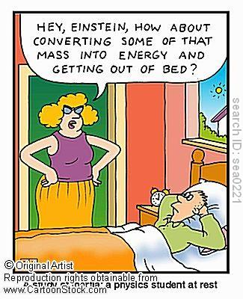
Forces and the Laws of Motion
Chapter 5

Slide 2
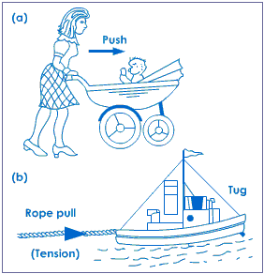
Force
A push or a pull, or any action that has the ability to change an object’s motion.
The SI unit of force is Newtons (N).

Slide 3
3 Ways a Force Changes Motion
1. Increase the speed of an object
2. Decrease the speed of an object
3. Change the direction in which an object is moving

Slide 4
Force
A force does not necessarily have to change the motion, but it must have the ability to do so.
Example: Push down on a table.
Conversely, there can be no change in motion without also having a force.

Slide 5
Forces can act through a contact or at a distance.
Contact force: A force that arises from the physical contact of 2 objects.
Field force: This force does not involve physical contact between 2 objects. For example: the attraction or repulsion between electrical charge, gravity
(Demos)

Slide 6
Four Fundamental Forces of the Universe
Gravity
Electricity/ Magnetism
Strong
Weak
(videos)

Slide 7
Newton’s First Law
“An object at rest remains at rest, and an object in motion continues in motion unless the object experiences a net external force.”
The tendency of an object to resist changing its state of motion is called inertia.
Newton’s 1st Law is also called the Law of Inertia.

Slide 8
Inertia
What about satellites?
What about rainbows?
All objects have mass.
What is mass? Unit for mass?
All objects have/or exhibit inertia.
Inertia is an inherent property of matter, just like gravity.
What about clouds?
What about lizards?

Slide 9
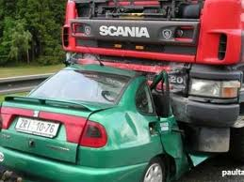
Inertia is a Property of Mass
The amount of inertia an object has depends on its mass.
More mass = more inertia = requires more force to overcome inertia

Slide 10
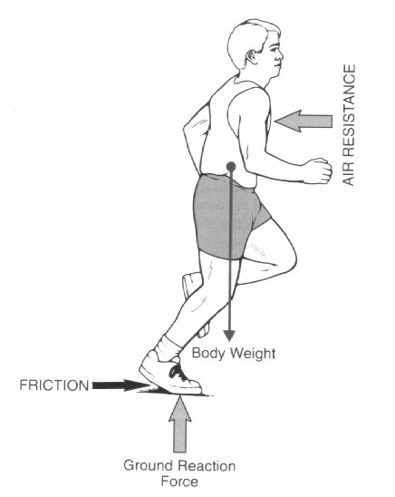
Net Force
If more than one force acts on an object along a straight line, then the forces will reinforce or cancel one another depending on their direction and magnitude.
Unbalanced forces will cause changes in speed or direction of an object’s motion.

Slide 11
Free Body Diagrams
A diagram of an object which includes only the forces exerted on the object.
A force has both magnitude (a size like 5N or 10N) and a direction (an arrow showing the direction the force is pushing or pulling).
FBDs help us visualize the situation and keep track of how the forces are acting.

Slide 12
Knowledge to Review
Acceleration = Δv/Δt = (v_{f}-v_{i})/Δt
Motion of an object with constant acceleration (kinematics notes)
Constant velocity means ZERO acceleration

Slide 13
Newton’s 2nd Law
Force is proportional to mass and acceleration.
The acceleration of an object is directly proportional to the net external force acting on the object and inversely proportional to the object’s mass. (Law of Force)
ΣF = ma (or a = F/m)
Net external force = mass x acceleration

Slide 14
Newton’s 2nd Law cont’d
$\sum{F}=ma_{net}$
This means “the sum of all the forces acting on an object are equivalent to that object’s mass times it’s net acceleration.”
Can also rewrite or expand like this:
$\left(F_{1}+F_{2}+F_{3}…\right)=ma_{net}$
Remember! Forces are vectors and direction matters.

Slide 15
Newton’s 3rd Law
“For every action there is an equal and opposite reaction.”
Forces occur in pairs because forces arise from the interaction of at least two objects.
Ex: - the Earth pulls on you and you pull on the Earth
- you push on a wall and the wall pushes back on you
- a bird’s wing pushes on the surrounding air and the air pushes back

Slide 16
Newton’s 3rd Law
If all forces occur in pairs, and are equal and opposite, why don’t all forces just cancel out?
Because the paired forces occur on different objects.
You pull on the Earth with exactly the same amount of force as the Earth pulls on you!
Why does this seem untrue?

Slide 17
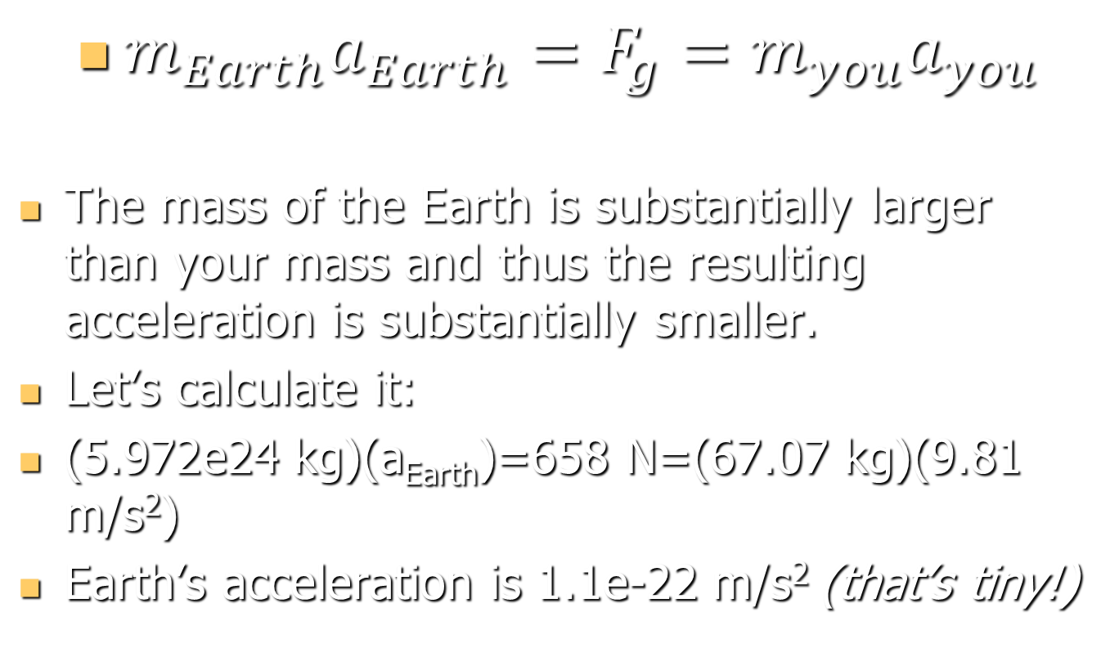
Newton’s 3rd Law cont’d
$m_{Earth}a_{Earth}=F_{g}=m_{you}a_{you}$
The mass of the Earth is substantially larger than your mass and thus the resulting acceleration is substantially smaller.
Let’s calculate it:
(5.972e24 kg)(a_{Earth})=658 N=(67.07 kg)(9.81 m/s²)
Earth’s acceleration is 1.1e-22 m/s² (that’s tiny!)

