Slide 1
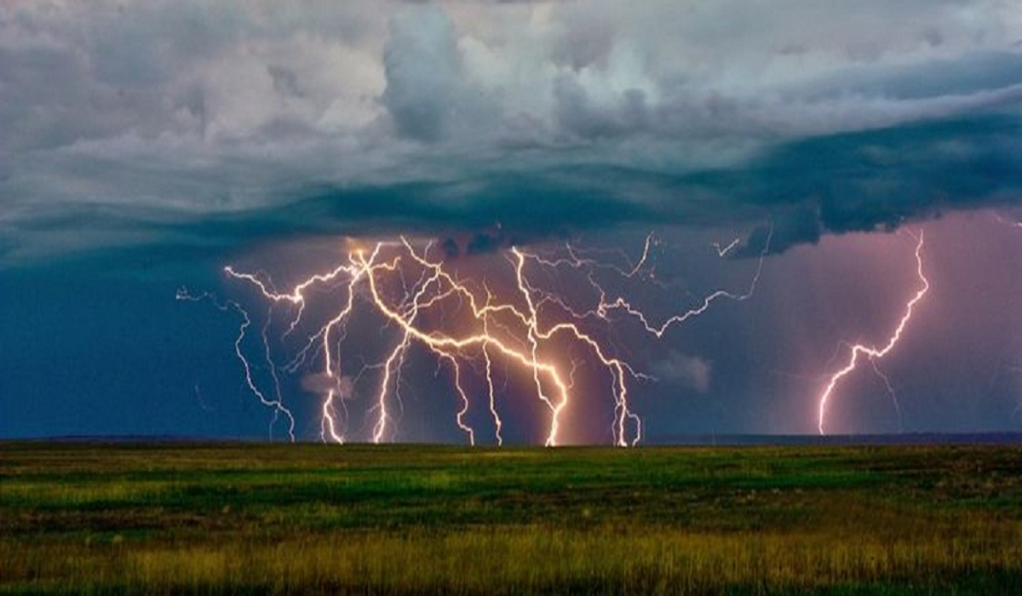
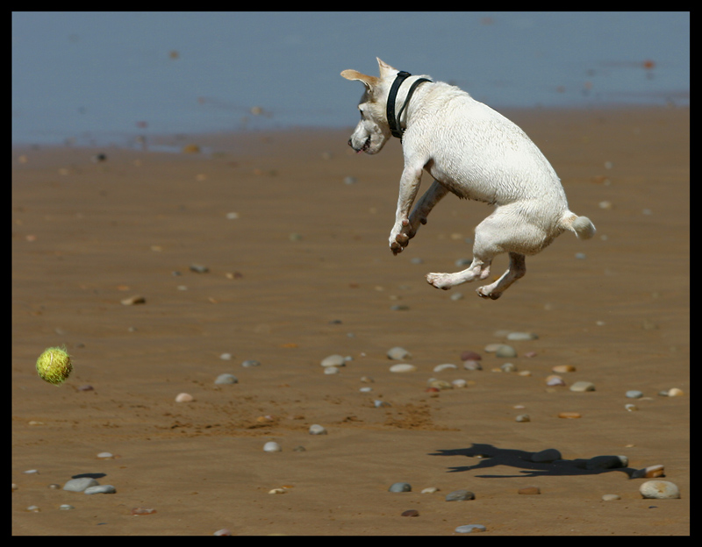
Energy
It’s what it’s all about!

Slide 2
What is energy?
Energy is the ability to do work.
Work is the transfer of energy.

Slide 3
Forms of Energy
Kinetic Energy
Energy of movement
Sound
Electrical
Thermal
Magnetic
Radiant
of Motion
Potential Energy
Stored energy
Gravitational
PE
Elastic
PE
Nuclear
PE
Chemical
PE

Slide 4
First Law of Thermodynamics
“Energy is always conserved; it can never be created or destroyed. Energy can only be transformed.”
Energy can be converted between the many forms on the previous slide.
Energy is transferred by the interaction of forces between objects.

Slide 5
Energy can be quantified.
KE = (½)mv²
PE_{g}= mgh PE_{elastic}= (½)kx²
E = mc²

Slide 6
Potential Energy
The energy an object possesses due to its position.
Gravitational PE is “stored” in the field between the object and the Earth.
Elastic PE is “stored” in the material itself as it is stretched or compressed.
Matter itself stores energy! How much, well... E=mc².

Slide 7
When PE is released, it usually transforms into KE.
When potential energy is tapped, an object is most likely set into motion. The energy of motion is described by kinetic energy.
PE + KE = ME (mechanical energy)

Slide 8
Kinetic Energy
KE = (½)mv²
Notice that velocity is squared!
So, as the velocity of an object doubles, the KE it has quadruples.
All alone, out in space, this has little significance. But if said object is on a path to collide with another object, then the amount of energy it has makes a difference.

Slide 9
Mechanical Energy
ME is the sum total of kinetic and potential energy of an object.
If ME is conserved, then PE transforms completely to KE, and vice-versa.
If ME is not conserved, then some of the energy was lost to heat (via friction) during the transformation.

