Slide 1
Buoyancy

Slide 2
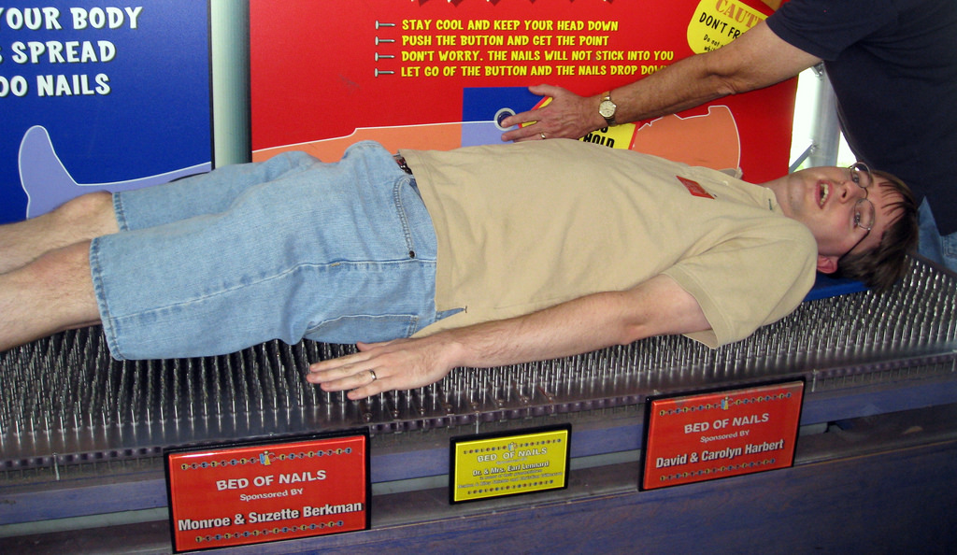
Compare standing on these surfaces to laying on them; what happens in each case?

Slide 3
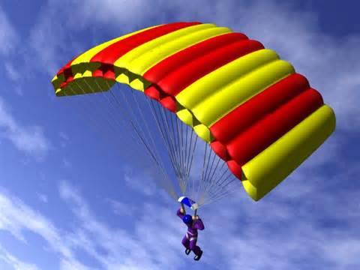
Which device will allow you to land safely? Why?

Slide 4
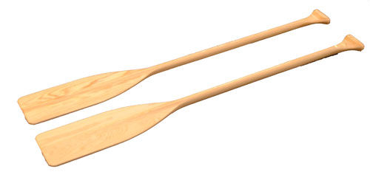
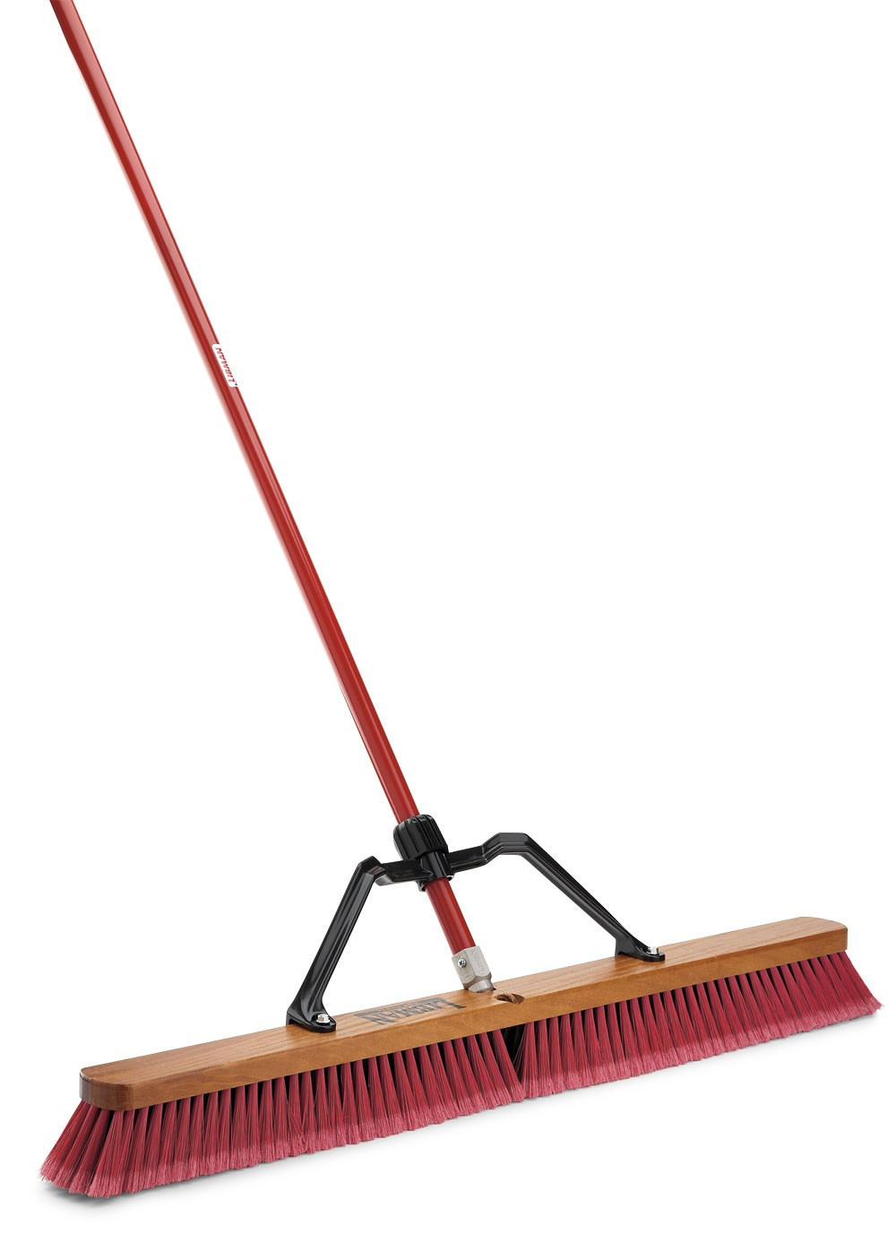
Which of these will move the largest volume of water with one motion?

Slide 5
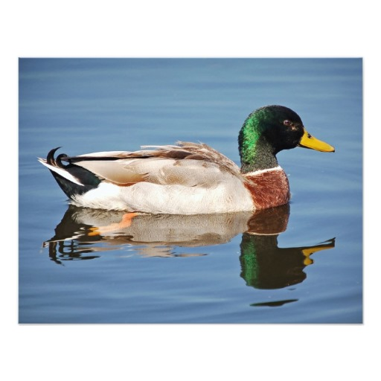
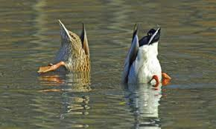
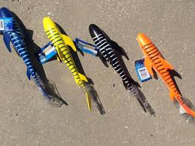
So, shape and size matter…
How is this shape different than the others?

Slide 6
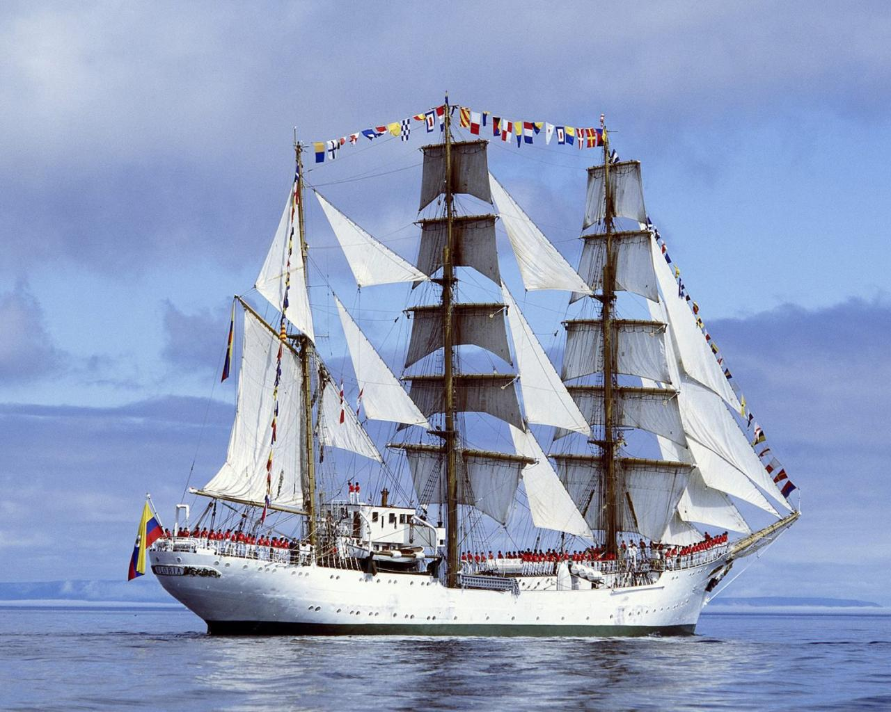
Buoyancy
Buoyancy – the ability of a fluid to exert an upward force on an object immersed in it
The buoyant force comes from water’s (or the fluid being used) resistance to being moved out of the way. Fluids settle according to gravity (always down), and all fluids have weight. It requires a force to move matter, and all fluids are matter. There are three cases for how the weight of an object and the buoyant force combine to act an on object. Let’s looks at those.
F_{buoy}
F_{weight}

Slide 7
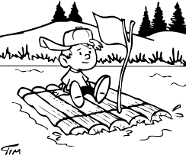
Case One: it floats! F_{buoy max}$>$F_{gravity}
As we established previously, shape and size matter. The maximum buoyant force on an object depends on the shape; better weight distribution through increased surface area yields more places for the fluid to push back, thus increasing the buoyant force.
100 N
…like a raft
This shape has a large surface area in contact with the water allowing a large column to resist it. This creates a large buoyant force.

Slide 8
Case Two: it sinks F_{buoy max} $<$F_{gravity}
100
N
This shape has only a small column of water to resist it. This creates a small buoyant force.

Slide 9
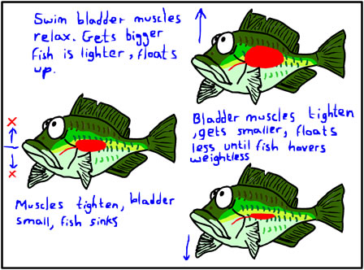
Case three: neutral buoyancy f_{buoy max} = f_{gravity}
Objects with neutral buoyancy will stay wherever they are put. If you put it low in the fluid, it stays low; if you put it higher in the fluid, it stays high. Neutrally buoyant objects neither float nor sink.
Submarines and fish exhibit neutral buoyancy.
How do submarines work? VIDEO
Floating up
Neutrally
buoyant
sinking

Slide 10
Compare the F_{buoy} to f_{gravity} for this object:
Notes:
The maximum buoyant force and gravitational force (or weight) on the iceberg are close, but the maximum buoyant force has not been reached, thus part of the iceberg is floating.

Slide 11
Some helpful or fun links
Buoyancy Basics by NOVA Science
Cartesian Squid Diver by S J James on YouTube
Buoyancy brainteasers by NOVA
In a nutshell by phillyseaperch.org

