Slide 1
Accuracy and Precision
Chapter 1 Section 2

Slide 2
Accuracy
Accuracy describes how close a measured value is to the true value of the quantity measured.
a.k.a “the right answer”, or the agreed upon answer (“consensus” among scientists)
Problems with accuracy are due to error.
Example: If a wooden meter stick gets wet, it can warp, making accurate measurements difficult to achieve.

Slide 3
Percent Error
-used to calculate the error in a measurement with respect to the accepted value
$\% error= \frac{\left|measured −actual\right|}{actual}×100\%$
For this class:
0 to 5% error; data set is considered accurate
5-10% error; data is acceptable
>10% error; data is not acceptable and the source of error should be identified

Slide 4
Precision – There are 2 meanings!
1) Precision refers to how closely a set of measurements agree
Data range is an indicator
Example- Here is a set of data:
What is the range of this set of data?
Is the range too big? Is it acceptable?
$\% diff=\left[\frac{range}{average}\right]×100\%$
7.8 g | 6.7 g | 8.0 g | 8.2 g | 7.9 g
<10% | Highly precise
11-20% | Acceptable precision
>20% | Not precise
Notes:
Avg = 7.72 g 7.72 g ± 0.75 g % difference is 19% the data set has barely acceptable precision
This is PRECISION of the data set.

Slide 5
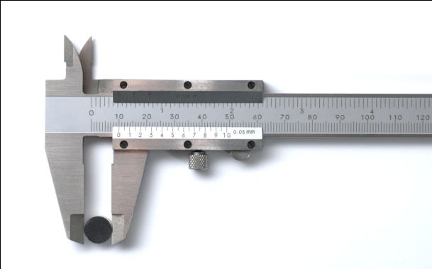
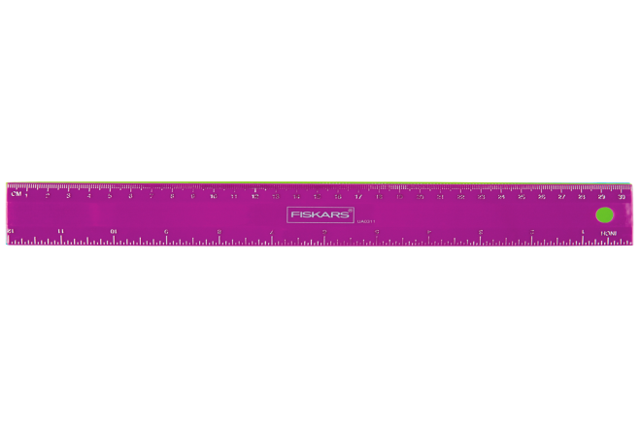
Precision of an instrument
2) Precision refers to the degree of exactness that a measurement can be made, and is limited by the measuring device or instrument used
how detailed your tool can measure (least count)
Example: A measurement of 1.325m is more precise than a measurement of 1.3m.
calipers vs. a ruler
Notes:
This is PRECISION of the instrument.

Slide 6
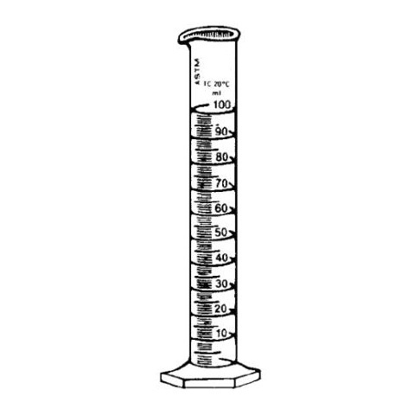
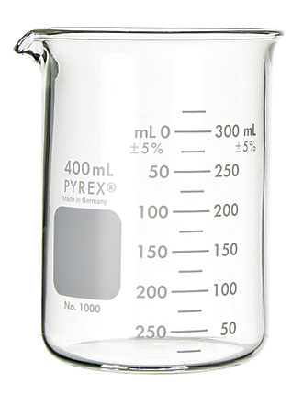
Another example: Precision
Which measuring device allows for more precision?
Which one could you more correctly measure 53 mL?

Slide 7
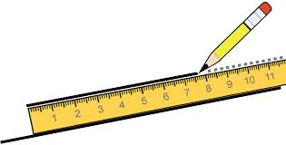
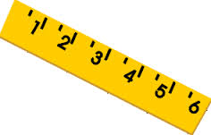
Measuring correctly
When using scientific instruments, measure to the least count, and then estimate the next digit.
Let’s practice. Assume both of these rulers refers to centimeters. Which has a smaller least count?
What is the length of each line?
Notes:
The first ruler: We all must agree that it’s at least 4.0 cm, because that satisfies least count. (versus 4.5 cm) We estimate the tenths place, and that is as far was we can reasonably go.
The second ruler: the picture is hard to read, but we would all have to agree to the same millimeter because it is least count; then we would estimate one digit past that. So, about 7.65 cm.
This would be a good place to refer back to the crayons from the mini-lab.

Slide 8
Lack of Precision
A lack of precision is typically due to the limitations of the measuring device or instrument.
Example: If I only have one meter stick and I want to measure the length of a city block. A meter stick was not intended to measure such large distances.
Example: Trying to measure the width of a human hair with a standard ruler will yield bad data because the least count lacks the necessary precision.
BUT, lack of accuracy is usually due to error.

Slide 9
Three Types of Error
Random – due to the small differences in measurements being read in different trials and by different people. When data is collected from an experiment, the overall differences should be within a small range. This is an acceptable type of error.
Systematic – usually due to an error in equipment calibration (see examples)
Human error – the experimenter is doing something incorrectly (unacceptable source of error)

Slide 10
Examples of Systematic Error
The wet (warped) meter stick from slide 2.
The triple beam balance not being zeroed out before the experiment.
Air ventilation blowing on a digital balance.
Errors in measurements of solar radiation because trees or buildings shade the radiometer.

Slide 11
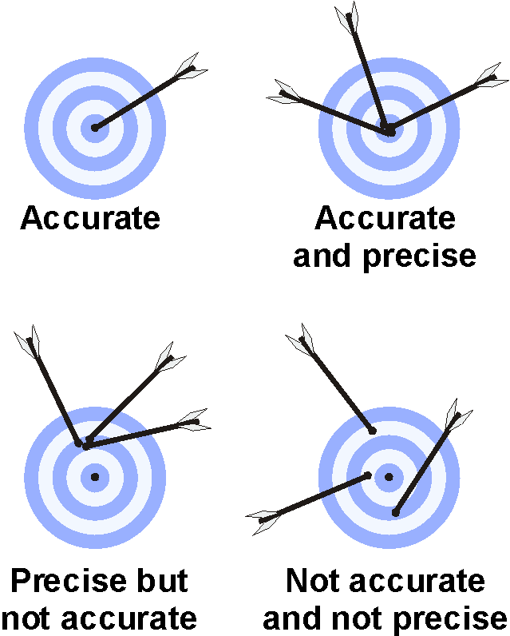
Accuracy and Precision
Notes:
This is a pictorial representation of how data sets can be. Be sure to ask students what type of error can be attributed to each of these cases.

Slide 12
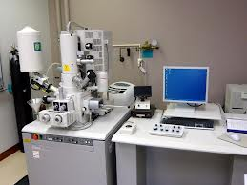
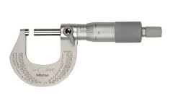
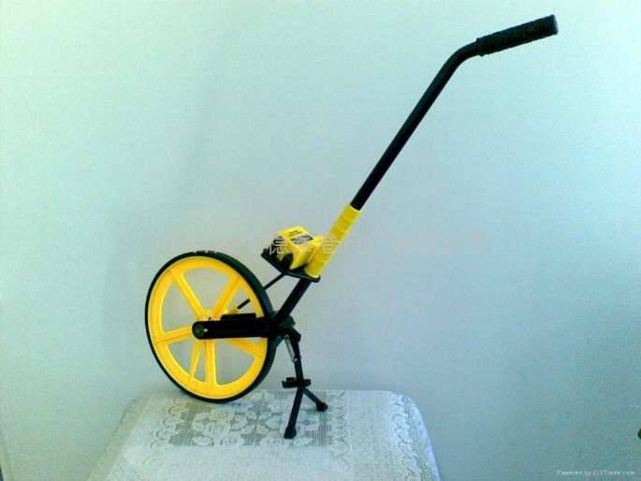
More Precision Instruments
micrometer
Electron scanning microscope
Walking wheel measuring “tape”
See Table 1 here for measuring long distances

